Slide 1
ISiK Medikation
Akteure und Use Cases
- Diskussionsgrundlage AG-Meeting 06.12.2021 -

Slide 2
Grundlagen/Quellen
IHE Actors
https://gazelle.ihe.net/GMM/tf/actor/listActors.seam
IHE Pharmacy Technical Framework Supplement
Hospital Medication Workflow (HMW)
(2013-10-11)
https://www.ihe.net/uploadedFiles/Documents/Pharmacy/IHE_Pharmacy_Suppl_HMW.pdf
IHE Pharmacy Technical Framework Supplement
Community Medication Prescription and Dispense (CMPD)
Rev. 1.8 (2020-01-27)
https://www.ihe.net/uploadedFiles/Documents/Pharmacy/IHE_Pharmacy_Suppl_CMPD.pdf

Slide 3
IHE-Akteure (1)
Q: https://gazelle.ihe.net/GMM/tf/actor/listActors.seam
Medication Treatment Planner: The main role of this actor consists in adding a new Medication Treatment Plan Item. It sends the cancelation of the planned item or its discontinuation, as well. In order to fulfill this task, the Medication Treatment Planner retrieves the current set of planned medications of the patient.
Prescription Placer: The main role of this actor consists in placing the prescription (initial or modified in case of a substitution of invalidation, for example). It sends the cancellation of the prescription or its discontinuation, as well. In order to fulfill this task, the prescription placer retrieves the current treatment of the patient and medication already dispensed recently.
The prescription placer receives the pharmaceutical validation and status tracking information such as substitution, availability, administration plan and reports and cancellation. The corresponding human actor is a prescriber.
Pharmaceutical Adviser: This actor is responsible for the validation of prescriptions from a pharmacist’s perspective. Therefore, it receives the initial prescription, validates it and sends it back (accepted, cancelled, modified, substitution of pharmaceutical product); therefore it provides the pharmaceutical advice. To perform this task it checks the current treatment.
The pharmaceutical advice can be due to clinical, legal, or supply aspects.
This actor may be implemented in the hospital pharmacy module of a hospital information system or the point of sale software of the pharmacy. The corresponding human actor is typically a pharmacist (or pharmacist assistant).

Slide 4
IHE-Akteure (2)
Q: https://gazelle.ihe.net/GMM/tf/actor/listActors.seam
Medication Dispenser: This actor is responsible for the process of dispensing medication to the patient, fulfilling the prescription. Therefore it produces the information on the medication dispensed to the patient. In order to achieve this, it receives prescriptions already validated. It also confirms drug availability for administration and it receives the administration plan and administration reports.
This actor may be implemented as the point of sale software of a community pharmacy or the hospital pharmacy module of a hospital information system. The human actor behind this system actor is usually a pharmacist or a pharmacist assistant.
In addition to the dispense, in this version this actor is considered to take care of all the dependencies to ensure a proper dispensing.
Medication Administration Performer: Receives instructions for administration of medications to patients, to perform the necessary checks and display it to the user (patient or healthcare professional)
Medication Administration Informer: The medication administration informer’s main responsibility consists in creating and placing the medication administration plan and the corresponding administration reports. In order to achieve this, it receives the initial prescription, the pharmaceutical validation or a “simple” substitution. It also receives the confirmation of drug availability for administration.
Through administration reports, the Medication Administration Manager actor reports, among others:
- The replacements (e.g., the 1g tablet by two 500 mg single dose packets)
- The follow-up (e.g., injectable follow-up)

Slide 5
IHE-Akteure (3)
Q: IHE CMPD 1.8, https://gazelle.ihe.net/GMM/tf/actor/listActors.seam
Medication Treatment Plan Repository: This repository contains the medication added to the patient’s plan from the Medication Treatment Planner and may receive updates to the current planning (cancelations, changes, etc.). It provides information about the planned medication to other actors such as the Community Pharmacy Manager.
Prescription Repository: This repository contains the medication prescribed to the patient from the Prescription Placer and may receive updates to the current treatment (cancelations, changes, etc.). It provides information about the prescribed medication to other actors such as the Community Pharmacy Manager.
Pharmaceutical Advice Repository: This repository contains the pharmaceutical advice issued by the Pharmaceutical Adviser (typically but not always a pharmacist). It provides this information to other actors such as the Community Pharmacy Manager.
Dispensed Medication Repository: This repository contains the medication actually dispensed to the patient; this information is received from the Medication Dispenser. It provides the dispensed medication of the patient to other actors such as the Community Pharmacy Manager.
Administered Medication Repository: This repository contains the medication actually administered to the patient; this information is received from the Medication Administration Performer. The Administered Medication Repository provides the administered medication of the patient to other actors such as the Community Pharmacy Manager.
Medication List Repository

Slide 6
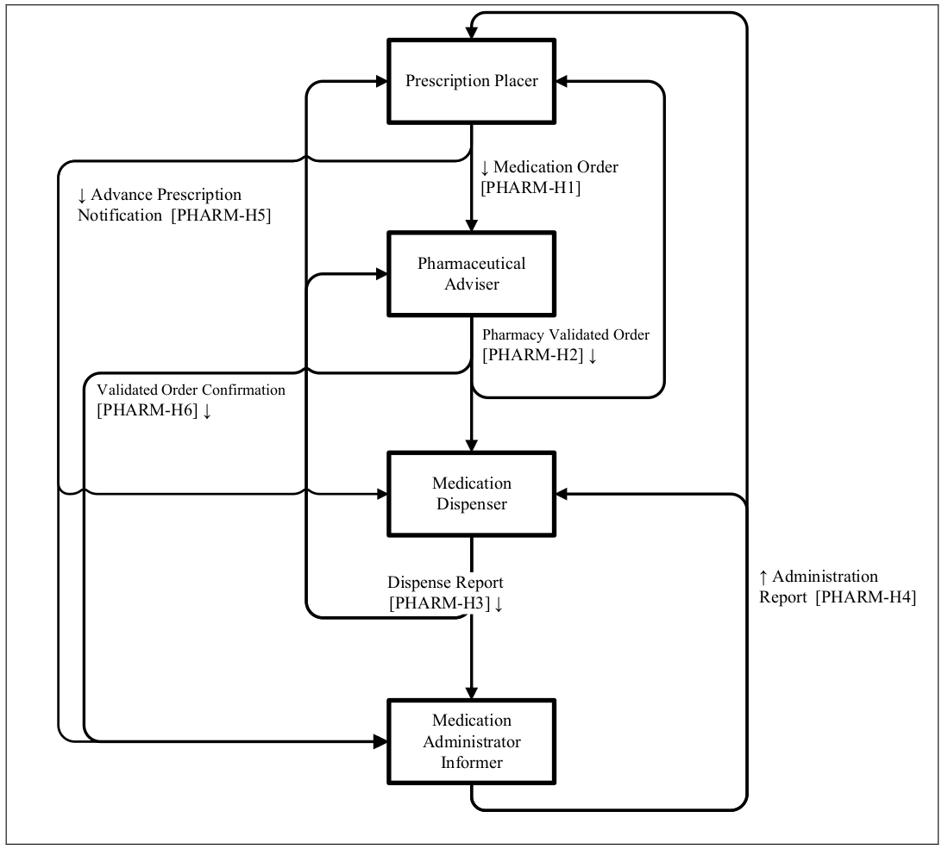
Workflow IHE HMW

Slide 7
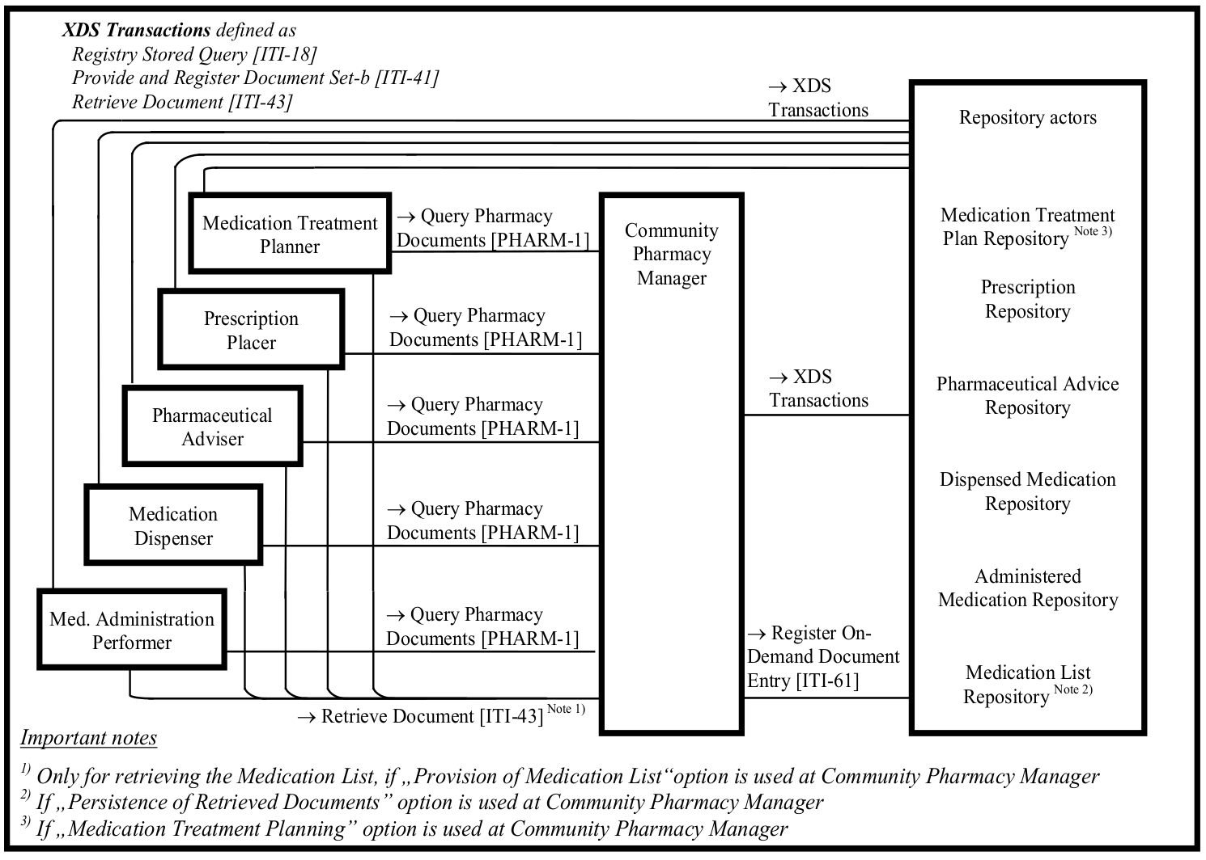
Workflow IHE CMPD

Slide 8
Begriffs-Überführung
IHE-Akteur(e) | ISiK-Akteur
Medication Treatment Planner | Medication Plan Provider
Medication Treatment Planner, Pharmaceutical Adviser, Prescription Placer | Medication Plan Consumer
Medication Treatment Plan Repository, Medication List Repository | Medication Plan Repository
Prescription Placer | Prescription Provider
Prescription Placer, Pharmaceutical Adviser, Medication Dispenser, Medication Administration Performer, Medication Administration Informer | Prescription Consumer
Prescription Repository | Prescription Repository
Medication Administration Informer | Administered Medication Provider
Prescription Placer | Administered Medication Consumer
Administered Medication Repository | Administered Medication Repository

Slide 9
Interaktion
X Repository
X Provider
X Consumer
X ∈ {"Medication Plan", "Prescription", "Administered Medication"}

